Slide 1


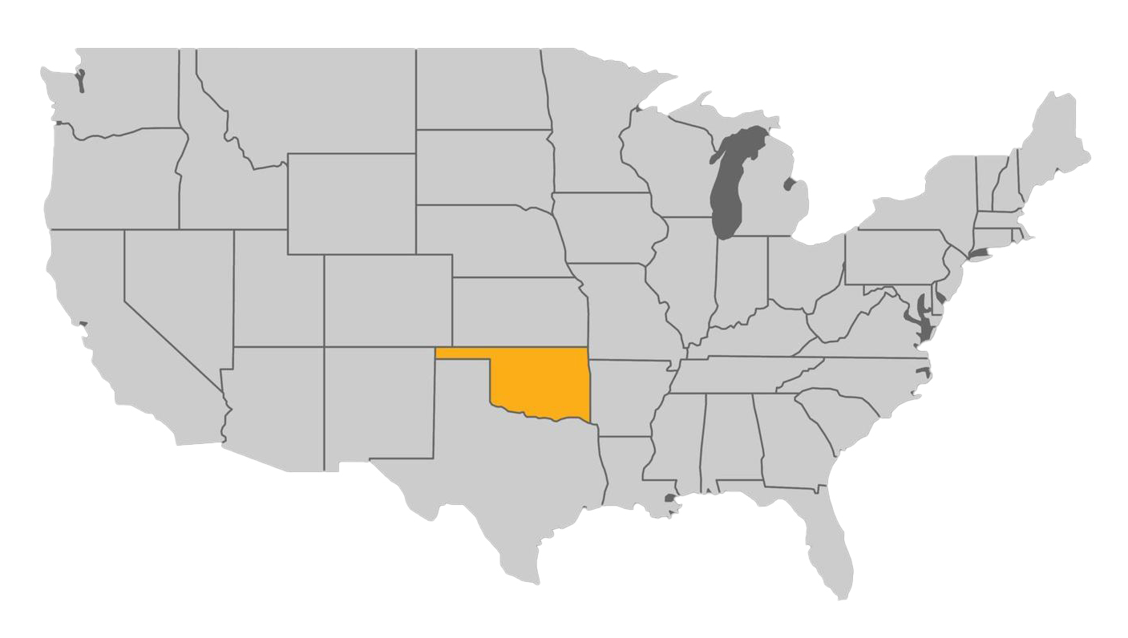



Khaled Mansy
University: Oklahoma State University
Study program: Architecture & Architectural Engineering
Years of study: Since being a toddler (60+)
City: Stillwater, Oklahoma, USA
Motto for life: “Be the Change you want to see in the World”, Mahatma Gandhi.
Hobbies: Travel, the outdoors, photography, … and anything outside of the routine life.
Your expectations from the summer school: Enjoy interaction with the young bright minds!
Location
Illinois Institute of Technology, Ph.D. with Honors, 2001

